Slide 1

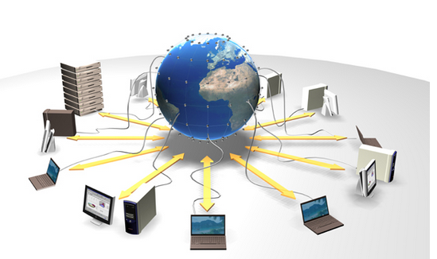
CSE 5307: Distributed Systems
Lab 2: RMI with Database & on different Machine

Slide 2
Learning Objectives
After completing this lab you should be able to:
Write an RMI program that uses database (MySQL)
Create and Execute client and server programs on a multiple machines

Slide 3
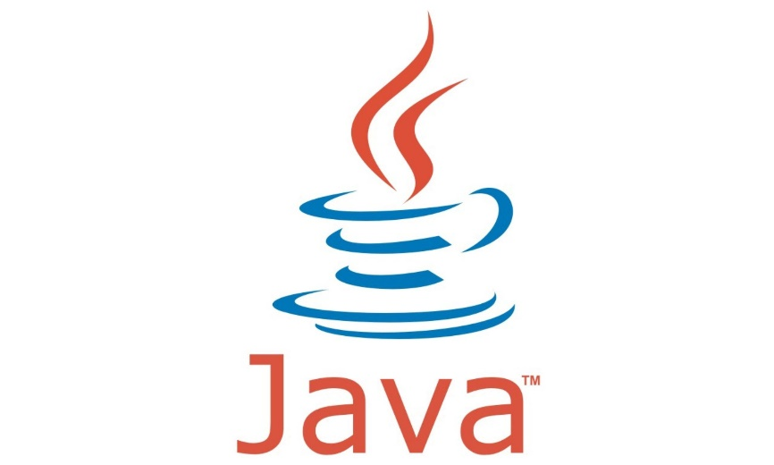
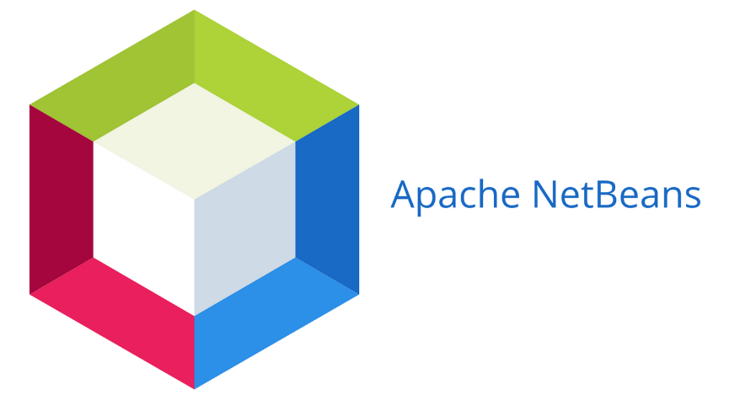
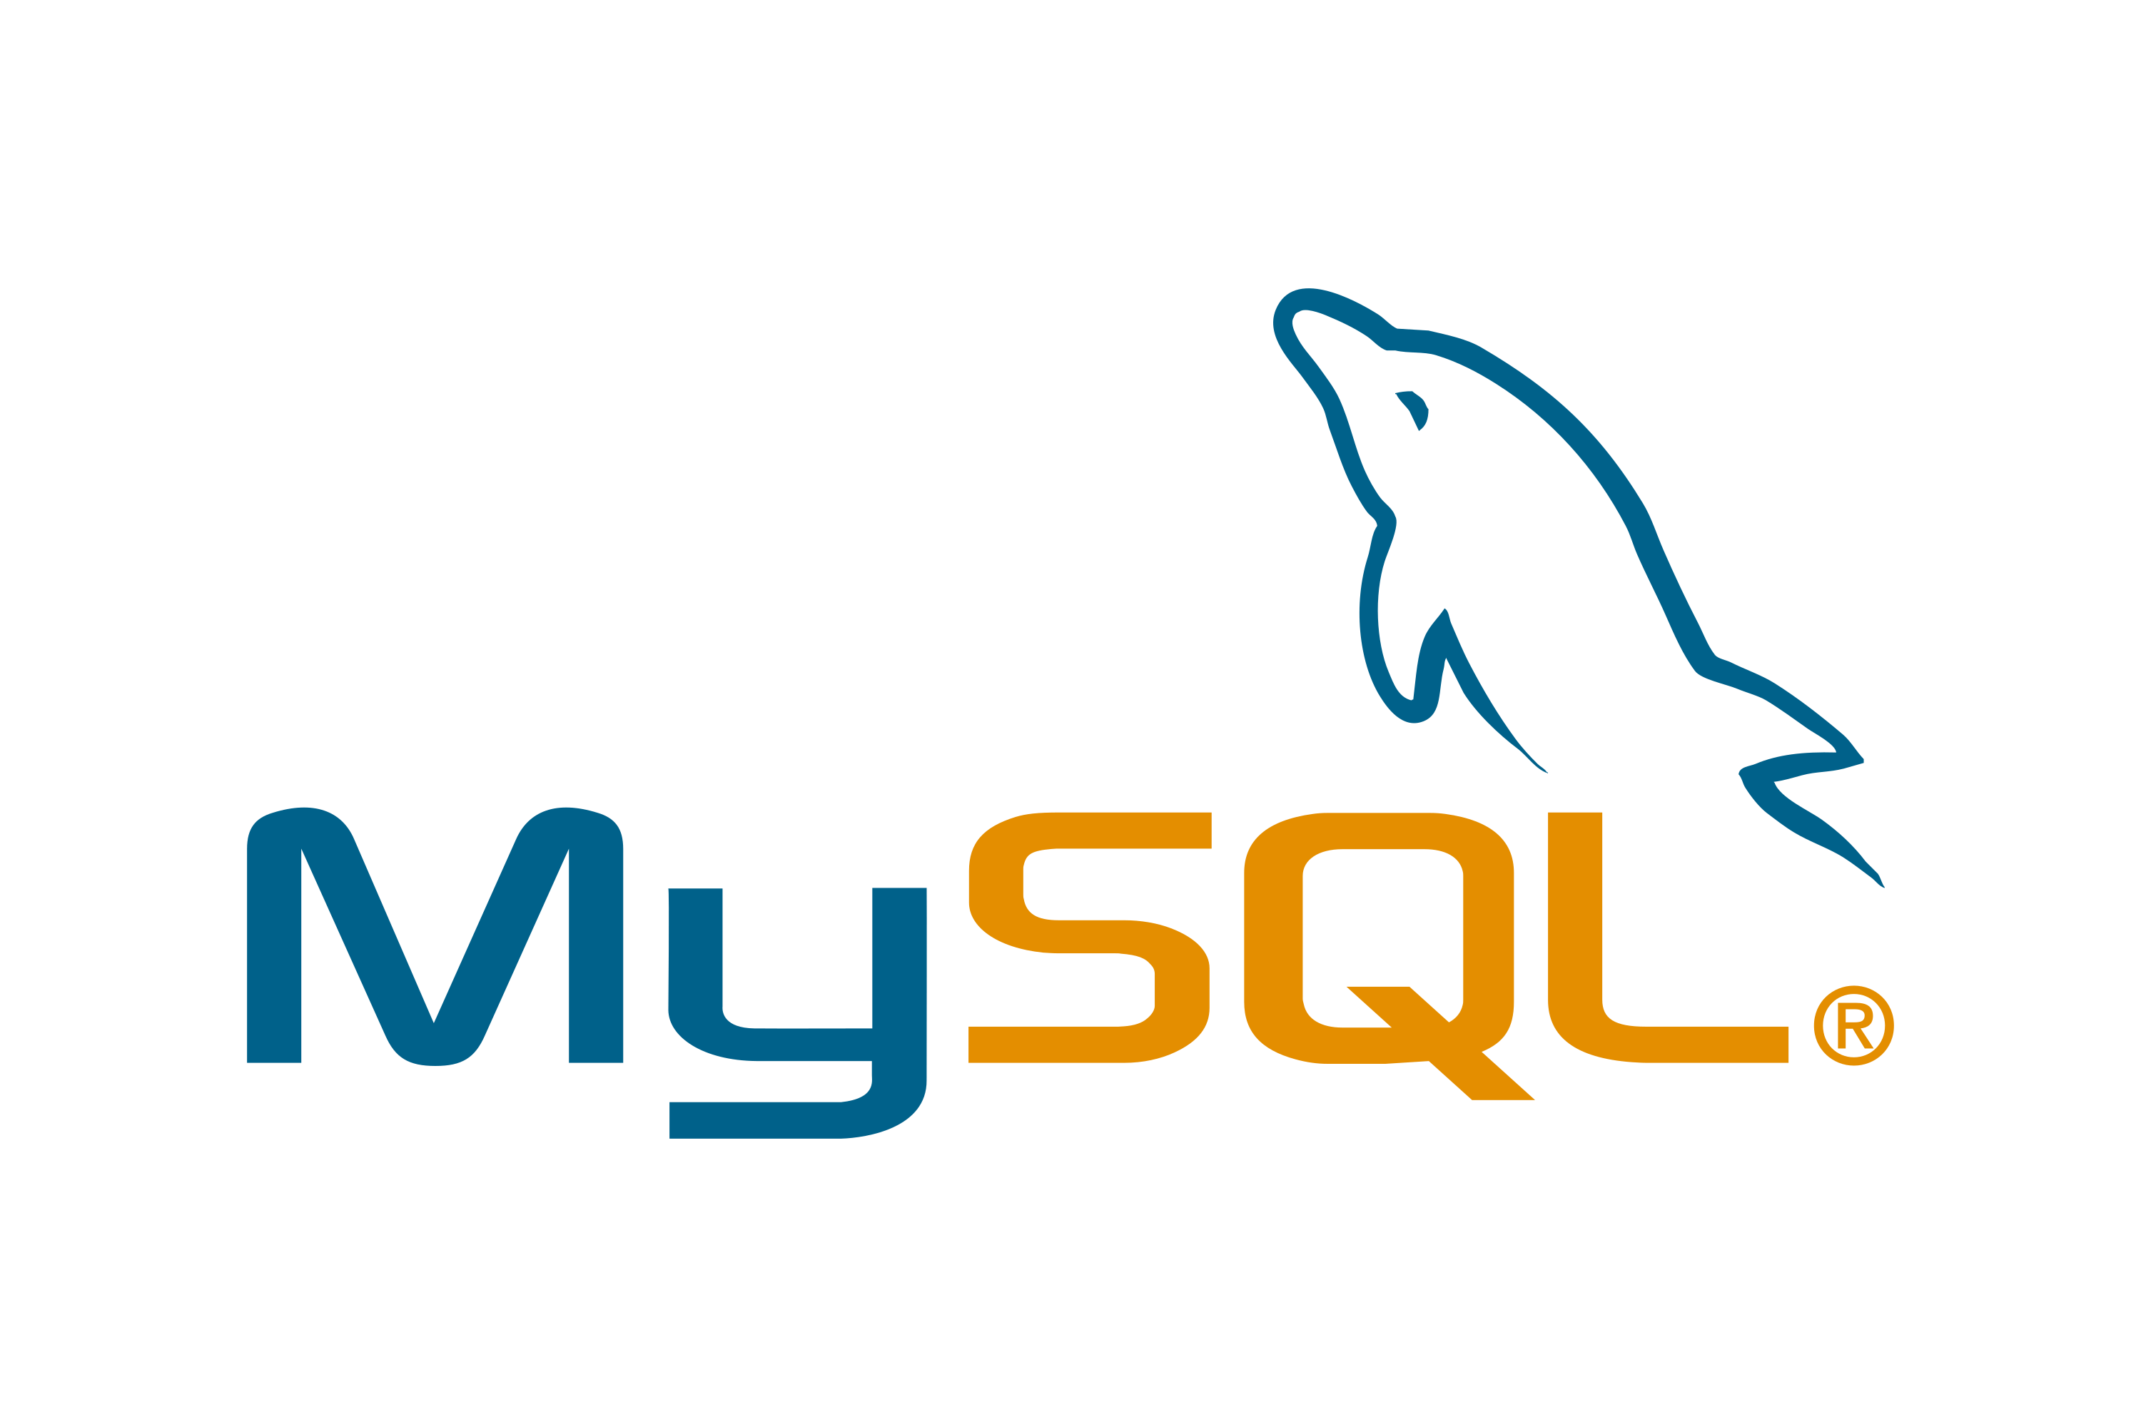

Tools needed:

Slide 4
Activity One: RMI with database
Steps:
Write the class which represents the data in the database
Start Xampp server & Create your database on MySQL
Write the remote interface class
Write the implementation to the remote interface class
Write the Server class
Write the client code
Run Server and Client

Slide 5
1: Write the class to represent your data
In this particular activity we will work on student data, thus our class will have the following attributes:
ID
Name
Department
Thus write a java class representing the above schema. You have to consider the following points:
The class should implement “java.io.Serializable”
All the member variables should be private
Write getter and setter methods to access the member variables

Slide 6
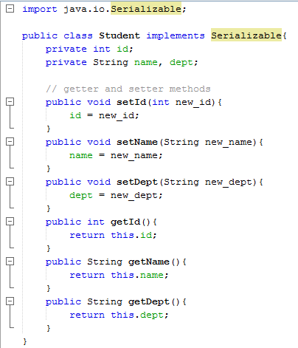
Student Class

Slide 7
2, 3 : Write Remote Interface
Start the Xampp Server and create the database representing the previous data schema
Then Write the Remote Interface code.
In this activity we will use a method to retrieve list of students on the database. Write writing the remote interface please consider the following:
The remote interface extends from java.rmi.Remote.
The method <getStudent()> throws java.rmi.RemoteException.
The method <getStudents()> takes no parameters
The method <getStudents()> returns an java.util.ArrayList of type <Student>.

Slide 8
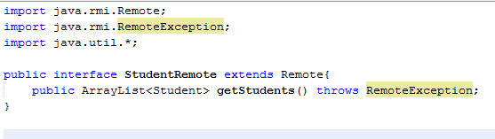
Remote Interface Class

Slide 9
4: Write Implementation of Remote Interface
Now we will implement the remote interface and write code to the <getStudents()> method. When writing the implementation consider the following:
Use <java.util.ArrayList> member variable in the method
Use try – catch block for the database access operation
Write necessary code to access the database and retrieve the data
You should know the user_name & password to your database. Also you should know the name of the table holing the data.
Add the retrieved data to the <ArrayList> variable and return it
Close your connection to the database after you are finished
Add MySQL jdbc connector to the netbeans java project

Slide 10
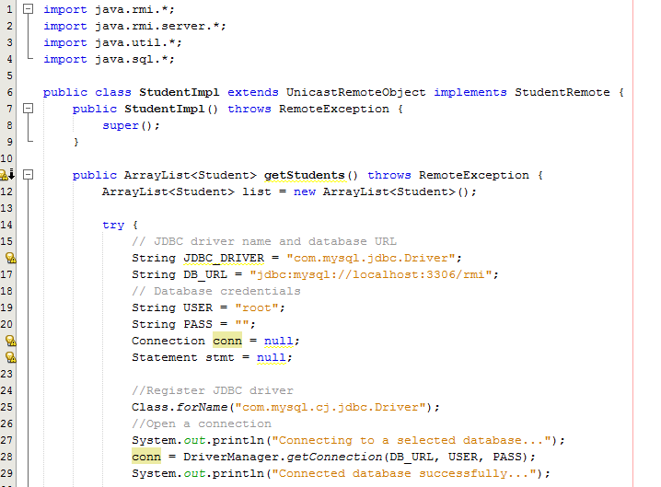
Remote Implementation Part 1

Slide 11
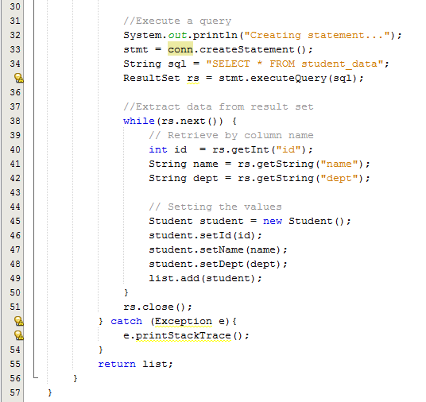
Remote Implementation Part 2

Slide 12
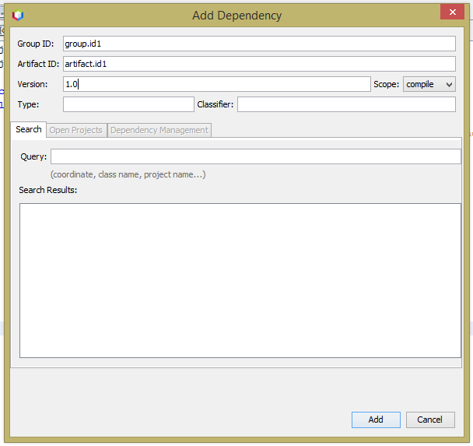
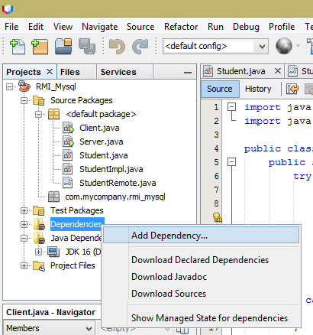
Adding MySQL db connector

Slide 13
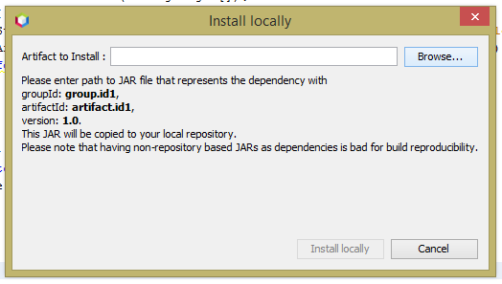
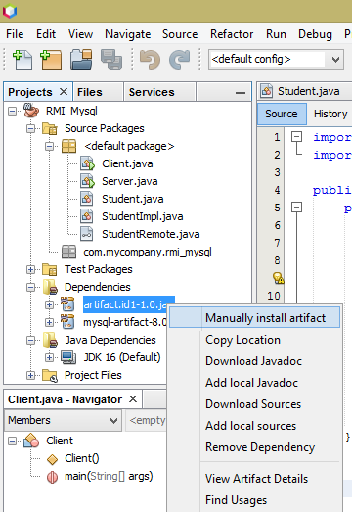

Adding MySQL db connector Continued …

Slide 14
5: Write the Server code to host the service
Now we will write the server code which will host the rmi implementation service.
Please consider the following points:
Start the rmi registry within the server code
Append the remote implementation service on the registry
Use try – catch block as needed

Slide 15
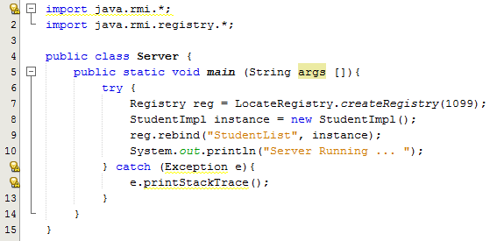
Server class

Slide 16
5: Write the Client class
Finally we write the client code to request the service, which in our case is list of students. When writing the client class please consider:
Looking up the rmi registry for the specific service
Retrieve the remote service and call the appropriate method
Assign the retrieved data to a variable with appropriate data-type
Iterate the data and display the results
Use try – catch block as needed

Slide 17
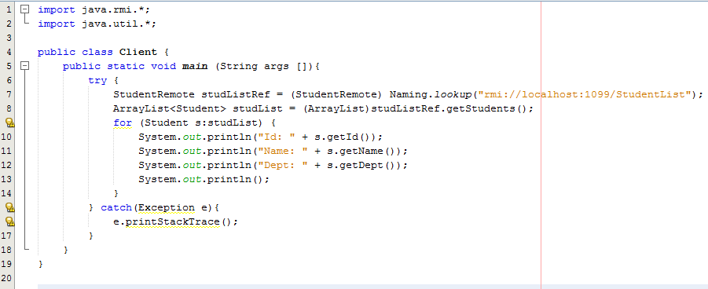
Client class

Slide 18
Activity One: Final Steps
Start the MySQL from Xampp server
Run the Server code
Run the Client code

Slide 19
Activity Two: RMI on different machines
This activity focuses on running the server and client code on different machines.
The only change to make is to replace the <localhost> or <127.0.0.1> ip on the client code, to the ip of the server.
The changed client code is shown on the next slide.
Note that the service name bind by the server and the service name requested by the client should match.

Slide 20
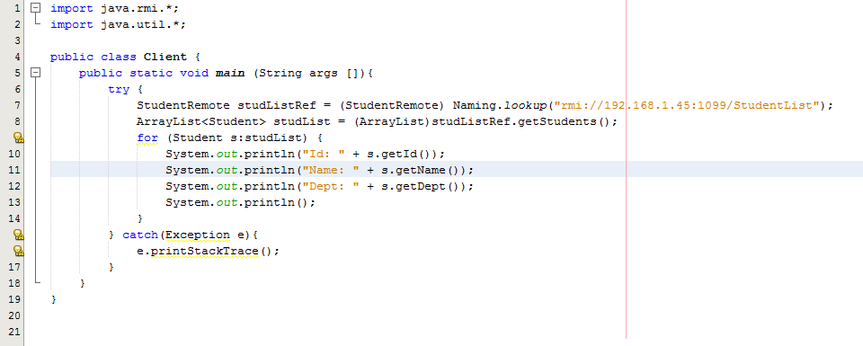
Client code accessing server on different machine

Slide 21
Lab 2 : Review Questions
What happens if we don’t implement < java.io.Serializable > when writing Student class?
When running rmi server and client, why don’t we need to specify ip for the server on the code used in the past activity?
What happens if you don’t add the java to database connector as a dependency?
What is the need for using getter and setter methods for java class member variables instead of directly manipulating them?
What happens if you try to retrieve a column on a database table that doesn’t exist?
Assignment (5 %)
Write a RMI program where the client sends the < id, name, dept> of a student and the server saves it to the database.
Consider using prepared statements
Accept data from user in real time

Slide 22
Thank You

